Slide 1
OUR INNOVATIVE IDEA “ONLINE VOTING SYSTEM”
We are preparing “ONLINE VOTING SYSTEM” to solve voting problem In this ERA of COVID-19. As present voting system needs pressing the buttom for vote which can be Vital source for spreading corona virus.
Second problem of present voting system is %age of Voters is less because all voters may not be present Voting Booth.so online voting can solve this problem.0 system We can use in Voting system “EIGN FACE ALGORITHM”
The main concept of “EIGN FACE ALGORITHM” is to follow the appearance based approach.

Slide 2

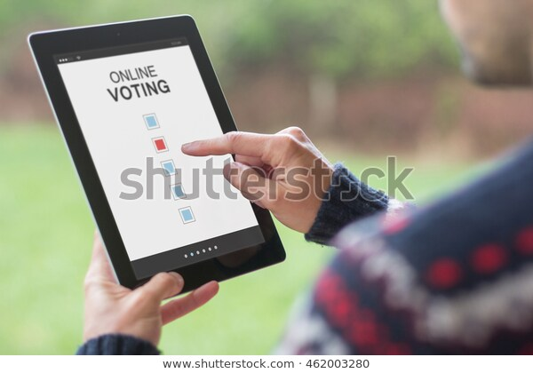

Slide 3
